Slide 1
Increasing Robustness
During Training
CSCI 4150/6050: Computer Vision
Many of the slides are from
Professor David Wingate (BYU)

Slide 2
The Three Pieces of Deep Learning
Labeled Data
  Do I have enough ground truth labels and images?
A Neural Network
  What mathematical operations am I performing on the images?
A Loss Function
  How does the network know when it is doing well?

Slide 4
We got all of these figured out. We are all done, right?
What could go wrong?

Slide 5


Slide 6
Things that could go wrong…
Stopping at a local minimum
  The system thinks it has reached a good solution when it hasn’t
Weight explosion
  The gradients push the weights up toward infinity
Overfitting
  The solution works well for the training data, but nothing else

Slide 7
Things that could go wrong…
Stopping at a local minimum
  Solution: Choosing a good optimizer and learning rate
Weight explosion
  Solution: Proper initialization and regularization
Overfitting
  Solution: Data augmentation and validation sets

Slide 8
Things that could go wrong…
Stopping at a local minimum
  Solution: Choosing a good optimizer and learning rate
Weight explosion
  Solution: Proper initialization and regularization
Overfitting
  Solution: Data augmentation and validation sets

Slide 9
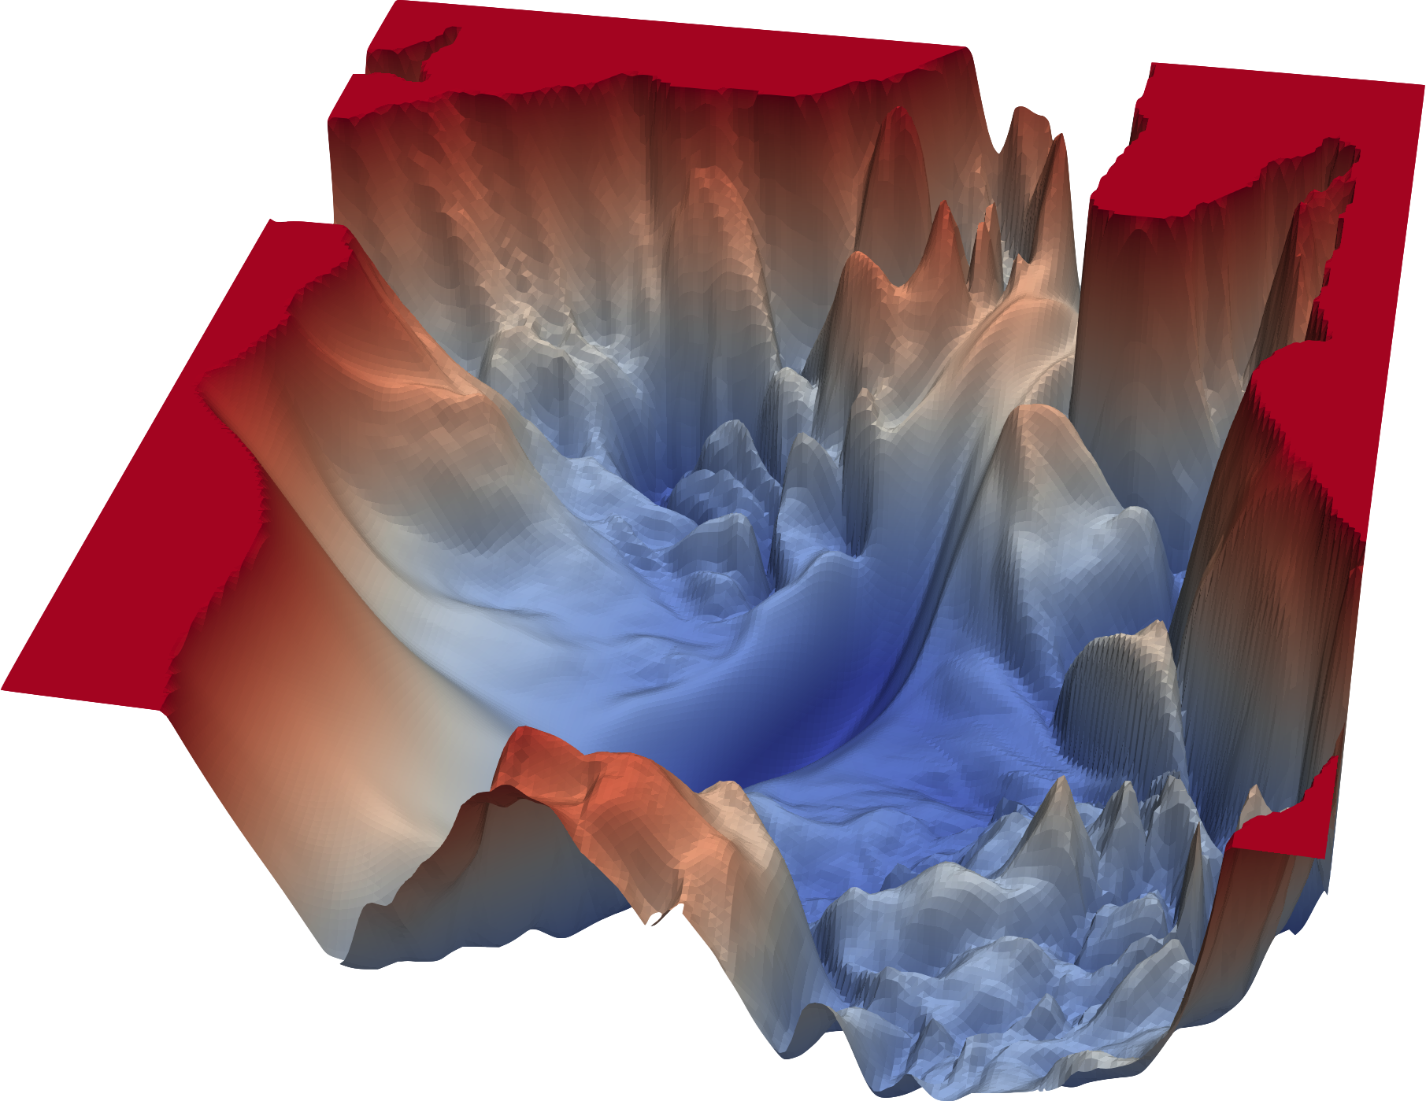
Visualizing the loss function space
The best answer is when the loss function is smallest. Assuming we have intitally 2 weights to optimise so the loss function is close to 0.
W1 and w2 randomply start somewhere in the red, do a step down and back propagation to know how much to change the weight so the loss goes closer to 0. ie gradient descent.
But in the case where the weights start at the local minimum ie bottom of small bowl, the step indicates moving in any direction only goes uphill so that was the local minimum, but now we loss the global minimum
*We generally only show 2D or 3D projections of the loss function space, but in reality, there are as many dimensions as there are parameters!
https://www.cs.umd.edu/~tomg/projects/landscapes/

Slide 10
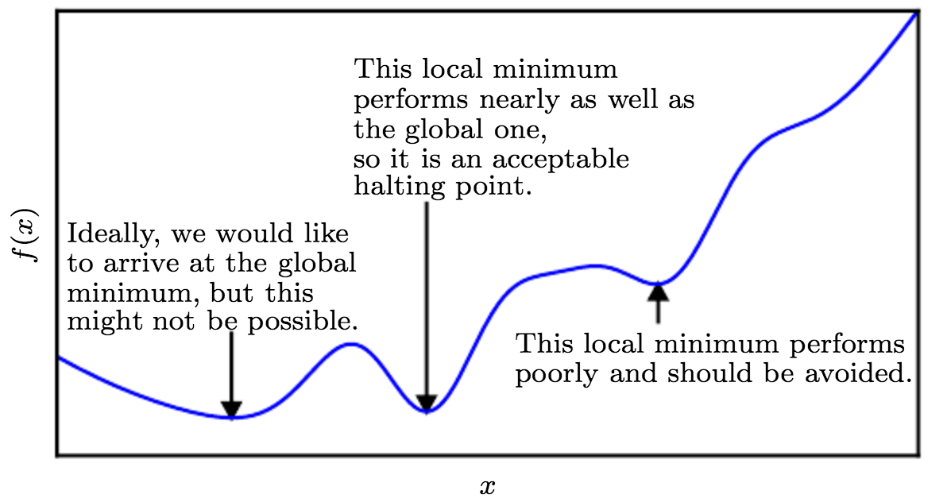
Challenges to CNN optimization

Slide 11
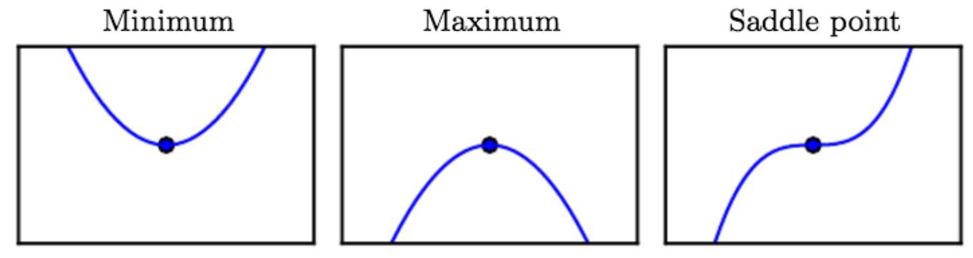
Challenges to CNN optimization

Slide 12
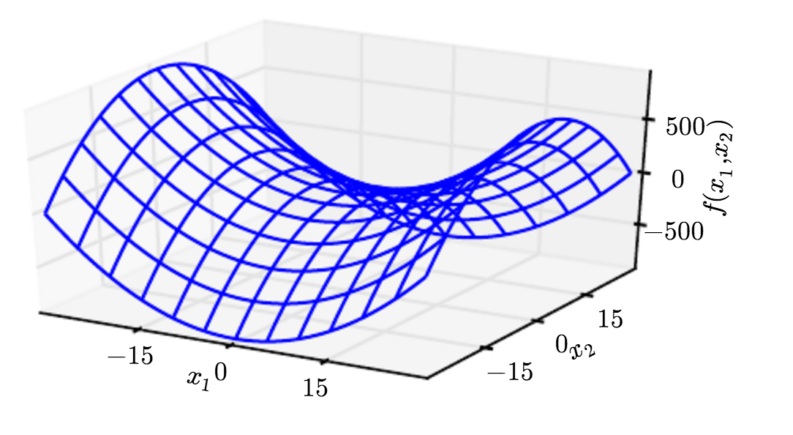
Saddle points

Slide 13
Key Idea: Optimizers and LR
Picking a good optimizer and learning rate (LR) can help prevent getting stuck in local minimums.
The optimizer determines which direction to move in the loss function.
The learning rate determines how far you step.
Learning rate too small, it may settle at a local minimum. Stepping too big, it may jump too much and miss the global minimum but do not converge. So the best is good enough to jump local minima but don’t jump
Over the global minimum. Best practices, start learning rate larger then reduce over time.

Slide 14
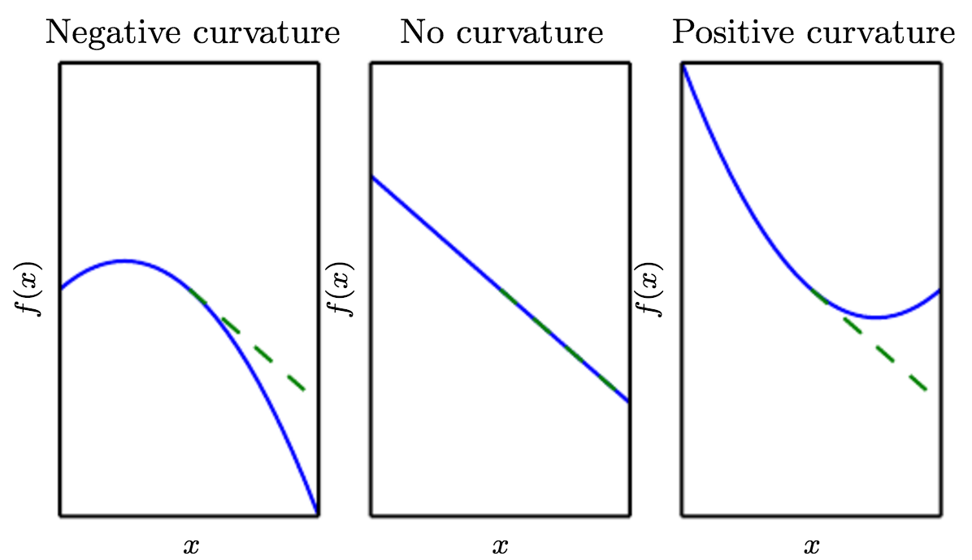
Curvature

Slide 15
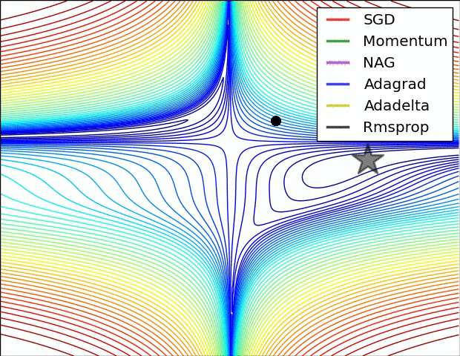
Different optimizer algorithms
(image credits to Alec Radford)

Slide 16
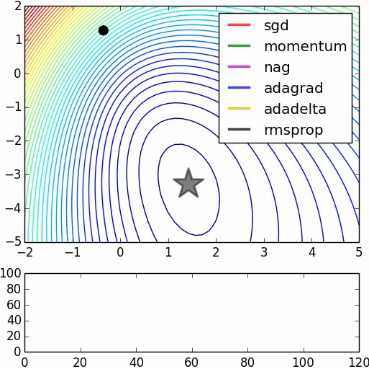
Different optimizer algorithms
I think stocastic gradient and momentum shoot the dradient very fast then starts coming back little by little.

Slide 17
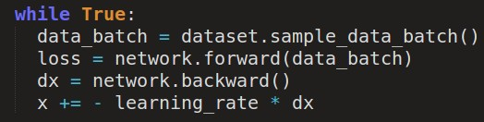
Option 1: “Good ol’” gradient descent
Manually coding it. But not in this class, we use built in pytorch method.

Slide 18
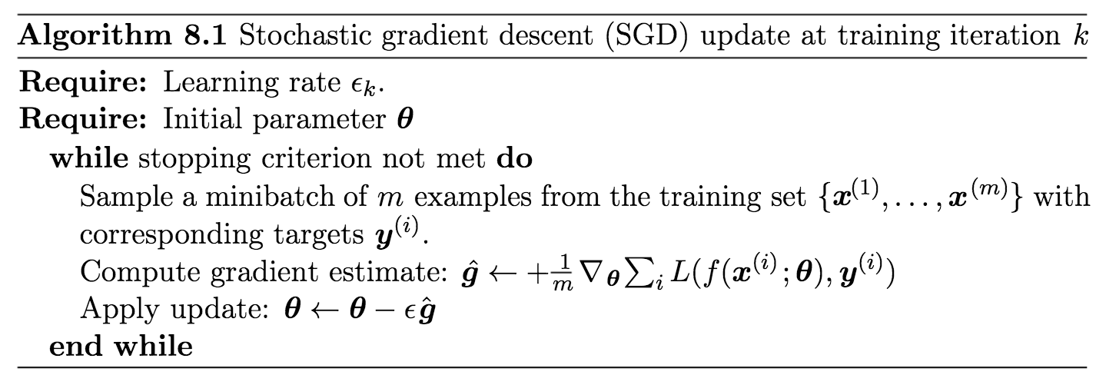
Option 1: SGD
Gradient descent is called Stochastic Gradient Descent (SGD) when it is operating on batches rather than the whole dataset.
SGD can be slow to converge because…
Because it doesn’t have a good way to counter act the gradient descent?

Slide 19
Suppose loss function is steep vertically but shallow horizontally:
Q: What is the trajectory along which we converge towards the minimum with GD?

Slide 20
Suppose loss function is steep vertically but shallow horizontally:
Q: What is the trajectory along which we converge towards the minimum with GD?

Slide 21
Suppose loss function is steep vertically but shallow horizontally:
Q: What is the trajectory along which we converge towards the minimum with GD? very slow progress along flat direction, jitter along steep one

Slide 22
Option 2: SGD with momentum
Problem: Learning with SGD can sometimes be slow
Solution: accumulate a “velocity”
  Can accelerate learning, especially in the face of
    high curvature
    consistent gradients
    noisy gradients

Slide 23
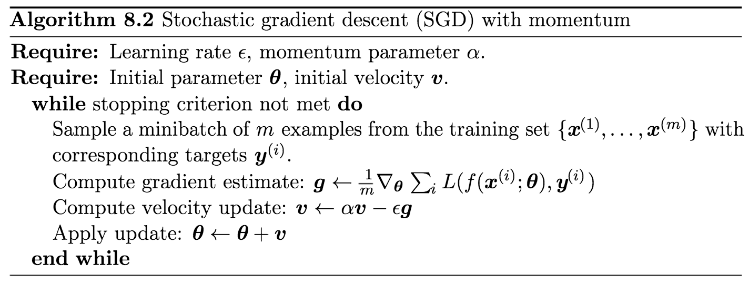
SGD with momentum

Slide 24
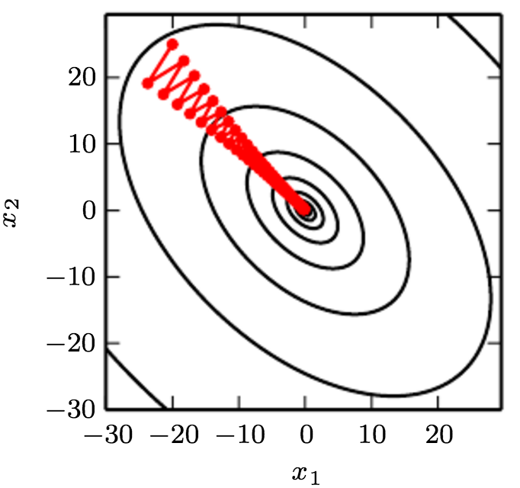
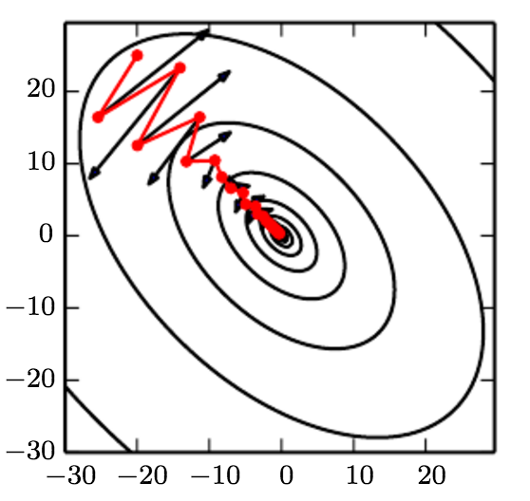
SGD with momentum
GD
GD w/momentum

Slide 25
Option 3: Adam Optimizer
This is what we use in lab6, its built into pytorch
Problem
  Learning rates are scaled, but still have variance in gradients
  Early estimates of momentum variables can be biased, especially in the beginning
Solution
  Put momentum terms on both gradient and squared gradient!
  Bias corrections for first and second order terms

Slide 26
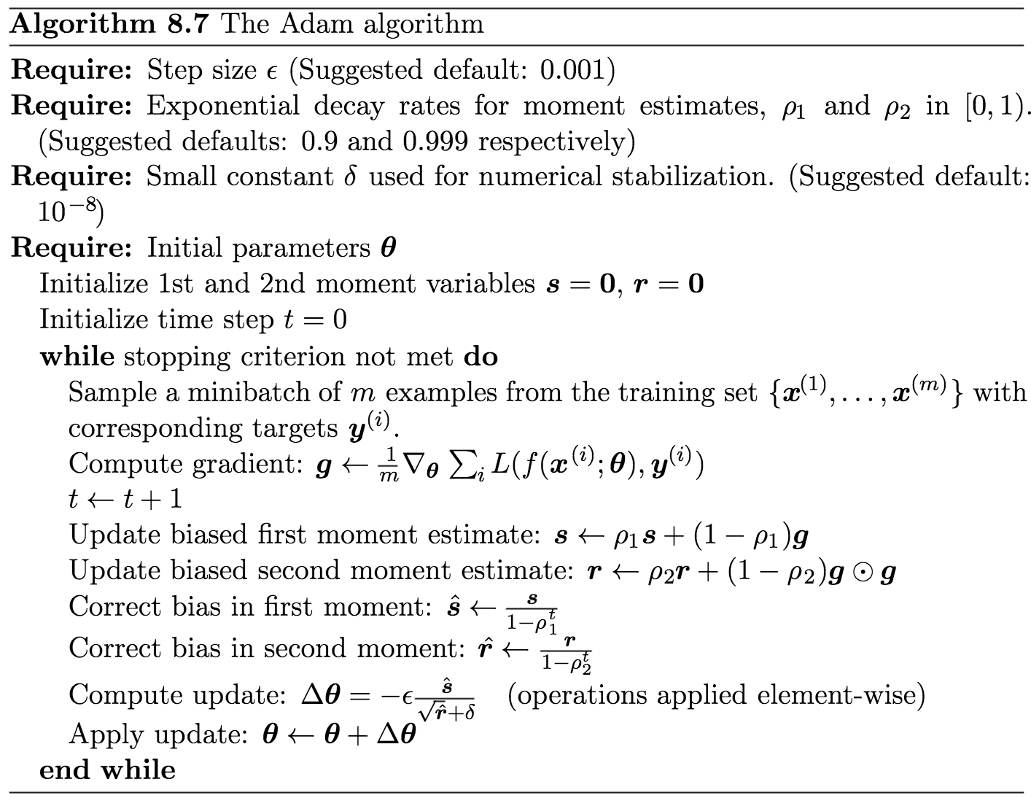
Adam (“adaptive moments”)
Kingma and Ba, 2014

Slide 27
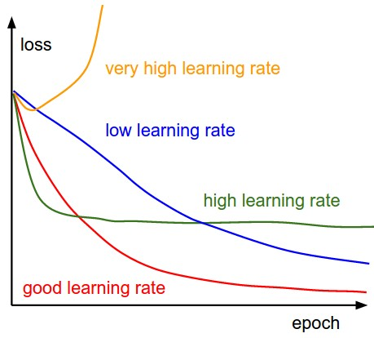
Learning Rates
Very high learning rate the gradients explode, it starts to go up the curve instead of down to the global min
1e-3 and 1e-4 ir 10^-3 are good starting points for learning rates..
The learning rate is how the optimizer decides how far to step.
If the learning rate is too high, the optimizer may become unstable or unable to settle in a local minimum.
If the learning rate is too low, it may take a long time to converge or settle prematurely in a bad local minimum.

Slide 28
White board visualization

Slide 29
TLDR: In practice, you should
Use Adam or AdamW. A learning rate of 0.001 or 0.0001 is usually a good start.
Try out SGD, especially when fine-tuning networks

Slide 30
Things that could go wrong…
Stopping at a local minimum
  Solution: Choosing a good optimizer and learning rate
Weight explosion
  Solution: Proper initialization and regularization
Overfitting
  Solution: Data augmentation and validation sets

Slide 31
Initialization Techniques
The weights for most layers in PyTorch automatically start with some random numbers that are determined inside of the reset_parameters function.
In general, how should those random numbers be distributed?

Slide 32
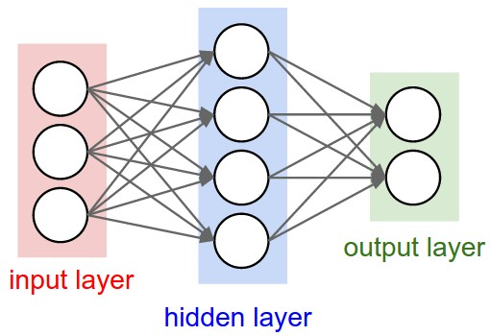
Q: what happens when W=0 init is used?
The primary operation is multiplication, so 0 times anything becomes 0 and that is already a very huge loss.

Slide 33
First idea: Small random numbers
(gaussian with zero mean and 1e-2 standard deviation)

Slide 34
First idea: Small random numbers
(gaussian with zero mean and 1e-2 standard deviation)
We can kill out network because we avergaed on each layer so losing standard deviation and variations and even signal to learn anything.
Works ~okay for small networks, but can lead to non-homogeneous distributions of activations across the layers of a network.

Slide 35
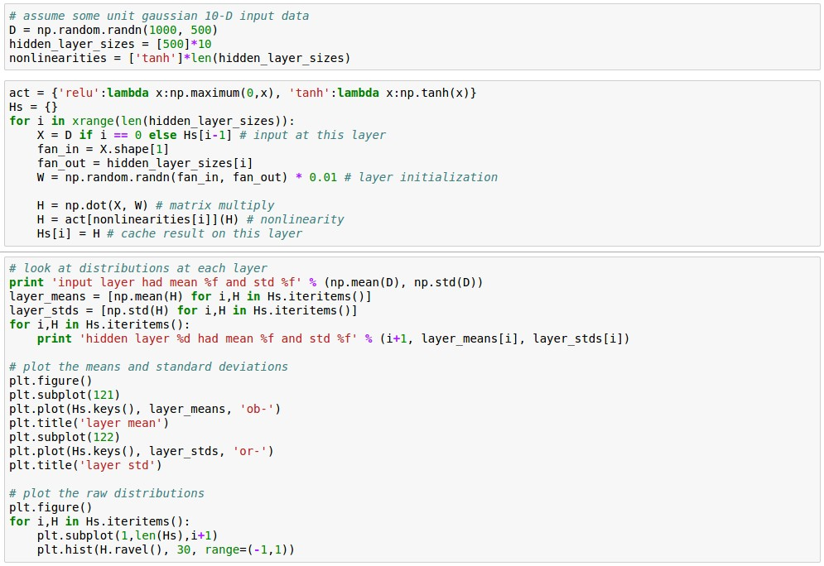
Lets look at some activation statistics
E.g. 10-layer net with 500 neurons on each layer, using tanh non-linearities, and initializing as described in last slide.

Slide 36
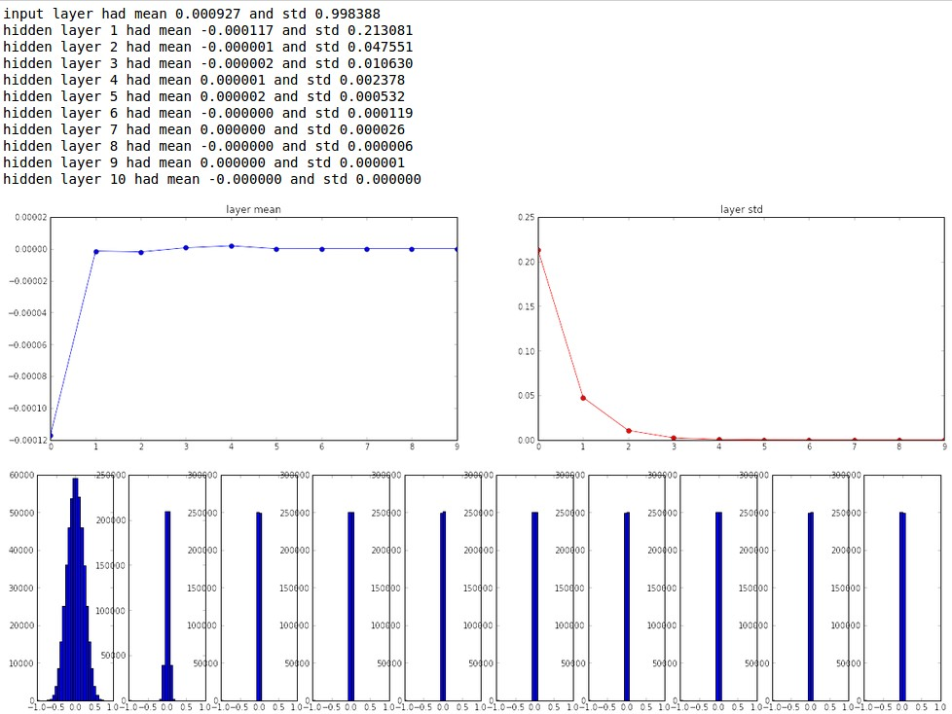

Slide 37
All activations become zero!
Q: think about the backward pass. What do the gradients look like?
Hint: think about backward pass for a W*X gate.

Slide 38
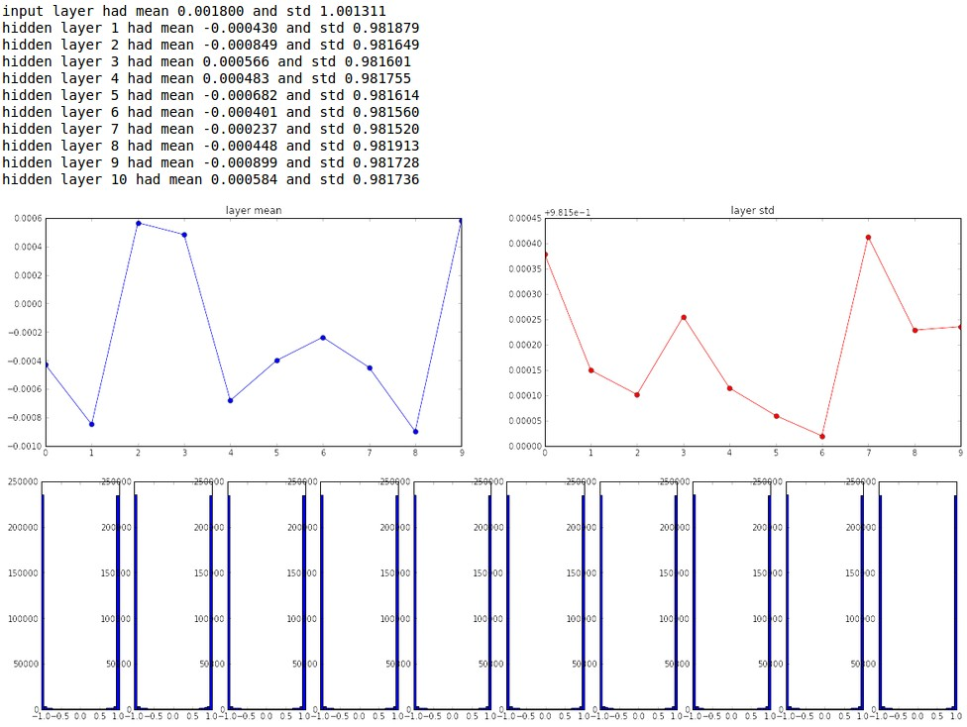
Almost all neurons completely saturated, either -1 and 1. Gradients will be all zero.
*1.0 instead of *0.01
So making them big still does not solve the problem.

Slide 39
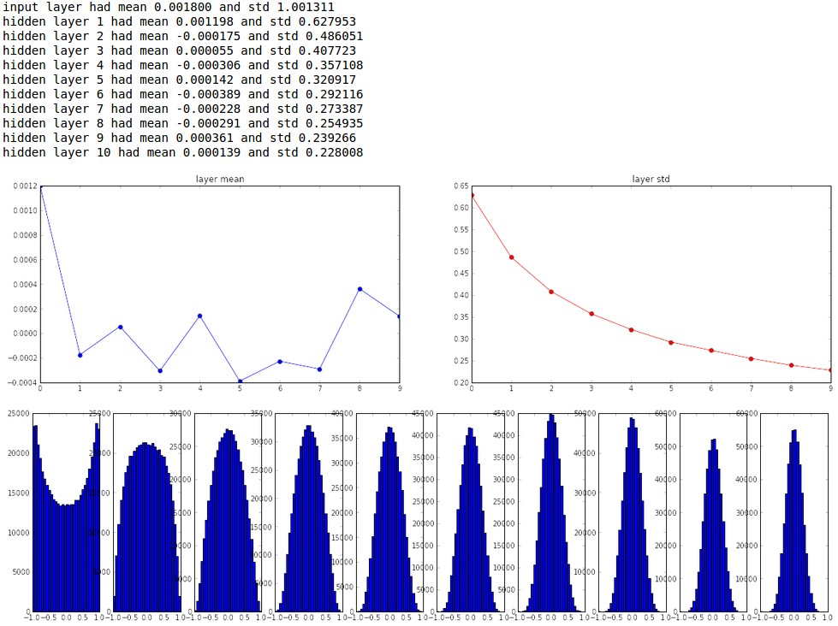
“Xavier initialization”
[Glorot et al., 2010]
Reasonable initialization.
(Mathematical derivation assumes linear activations)
This initialises wide and as it goes deep the initialisation gets wider and wider so even
As we average instead of the shringking efect we make the
Guassian distribution wider as the network gets deeper.

Slide 40
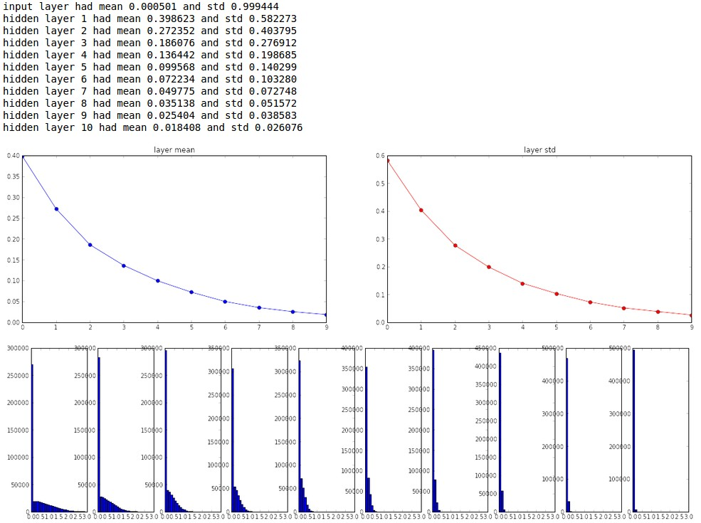
but when using the ReLU nonlinearity it breaks.
It breaks because ReLu uses only +ve values?

Slide 41
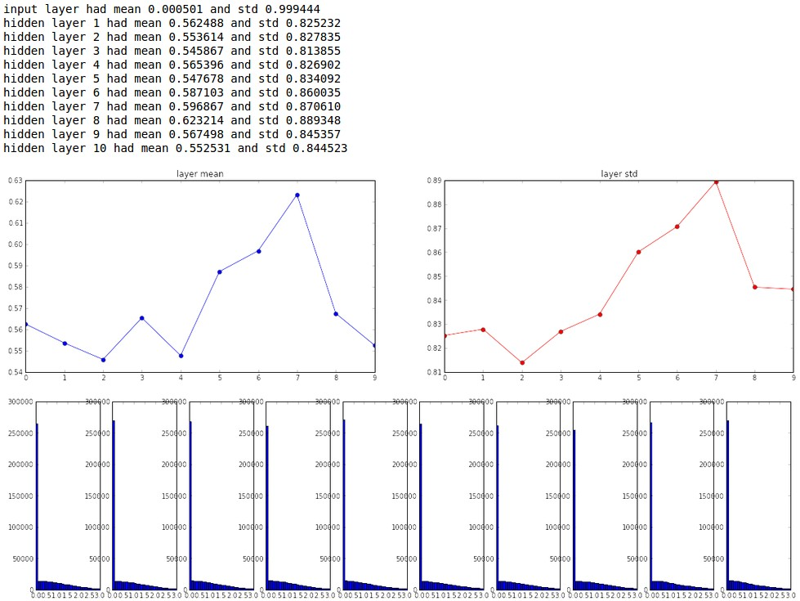
He et al., 2015
(note additional /2)

Slide 42
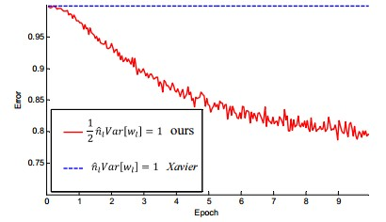
He et al., 2015
(note additional /2)

Slide 43
Often called “Kaiming Uniform”
This is the default built in pytorch.

Slide 44
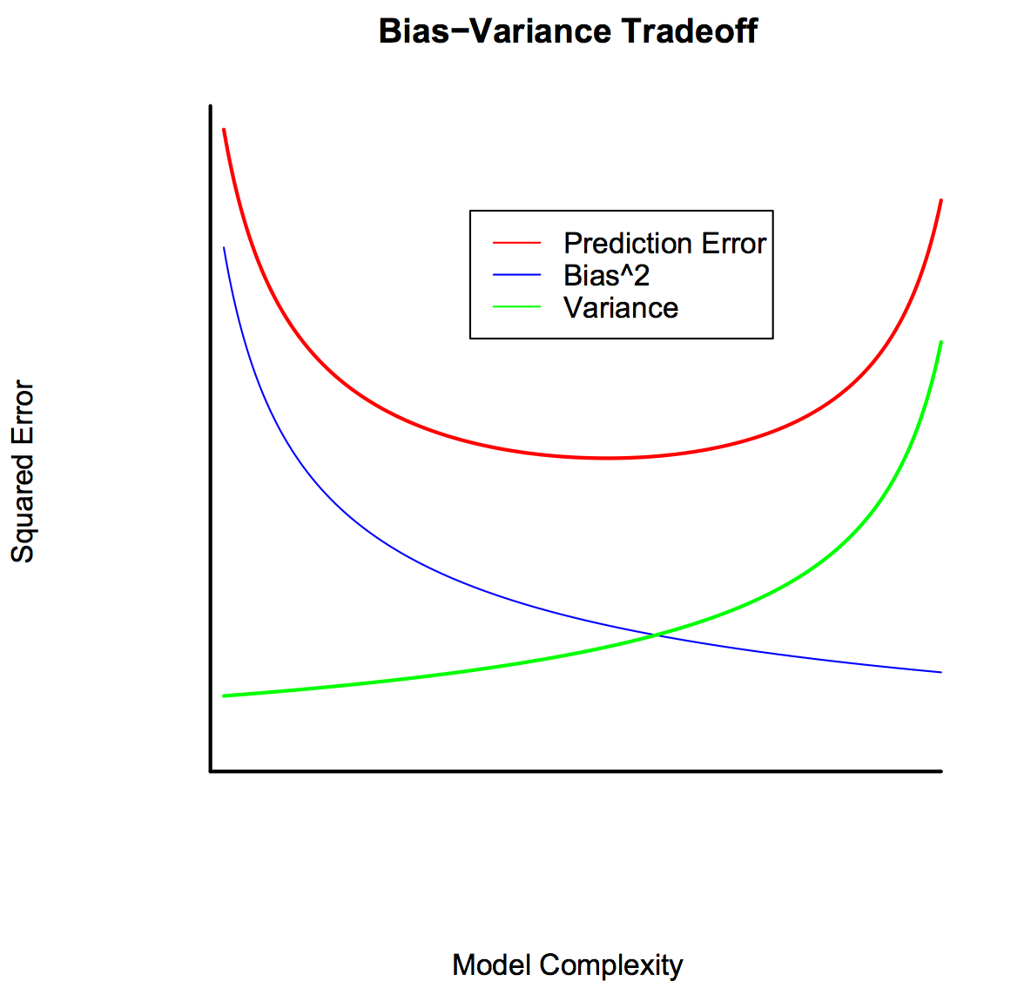
Regularization themes
Reduces overfitting by favoring “simpler” models
Bias-variance trade-off
Some regularizers encourage sparsity (known as “sparsity-encouraging”)
As we make the network large (green), the more the error goes down (blue) but it doesn’t
Do well on the testing data(red) instead stop at the flat or generalisation surface
This is due to overfitting over time.

Slide 45
A general rule is that, as a statistical method tries to match data points more closely or when a more flexible method is used, the bias reduces, but variance increases.
Notes:
Linear regression: high bias, low variance
Where are DNNs?

Slide 46



The objecttive is to minimise classification loss, but also the regularisation on the weight (prior) insists that the weight should be smaller, ie look for simpler solutions that don’t need large weight values
To pprevent memorisation. Smaller weights equal simpler solutions and no memorisation of extreme patterns.
Strategy 1: Weight Regularization
In common use:
L2 regularization
L1 regularization
Elastic net (L1 + L2)
𝜆 = regularization strength
(hyperparameter)

Slide 47
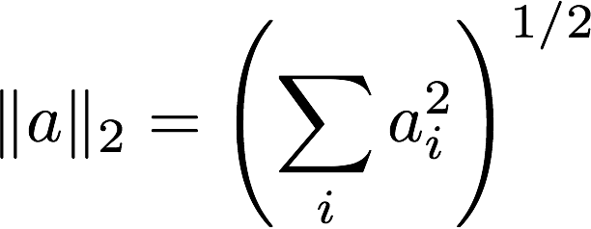
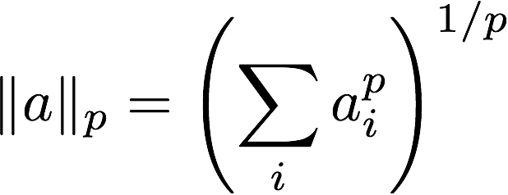
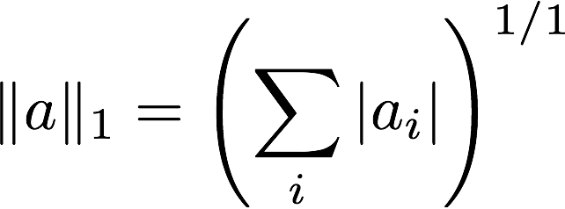




Reminder: Norms
Euclidean norm (L₂)
Minkowski norm
Manhattan norm (L₁)
p = 0
…
Max norm (L∞)
…
L₀ norm

Slide 48
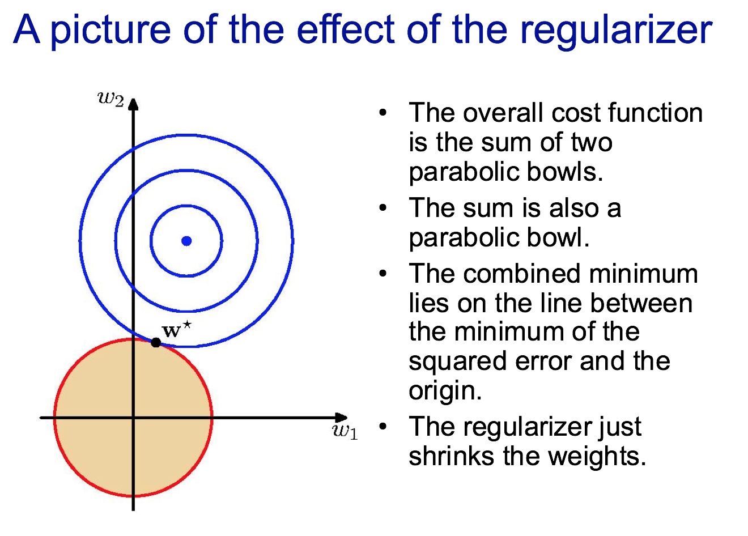
Slide credit: Geoff Hinton, CSC2515

Slide 49
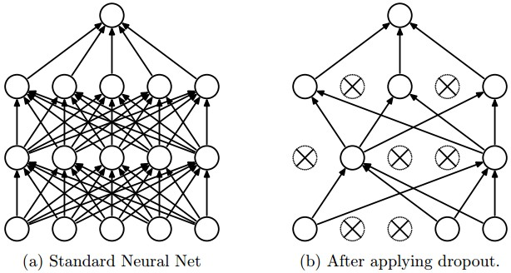
Strategy 2: Dropout Regularization
“randomly set some neurons to zero in the forward pass”
[Srivastava et al., 2014]

Slide 50
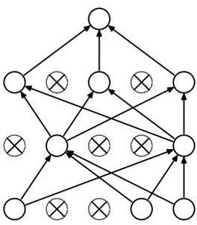
Waaaait a second…
How could this possibly be a good idea?

Slide 51
So if a large outlier is on any property, it still has other patterns to correctly identify the answer. This is done only during training, but in testing it can use all its labs
So it has more than enough info to correctly predict.
Waaaait a second…
How could this possibly be a good idea?
Forces the network to have a redundant representation. And not lean heavily o one
has an ear
X
has a tail
is furry
X
cat
score
has claws
X
mischievous
look

Slide 52
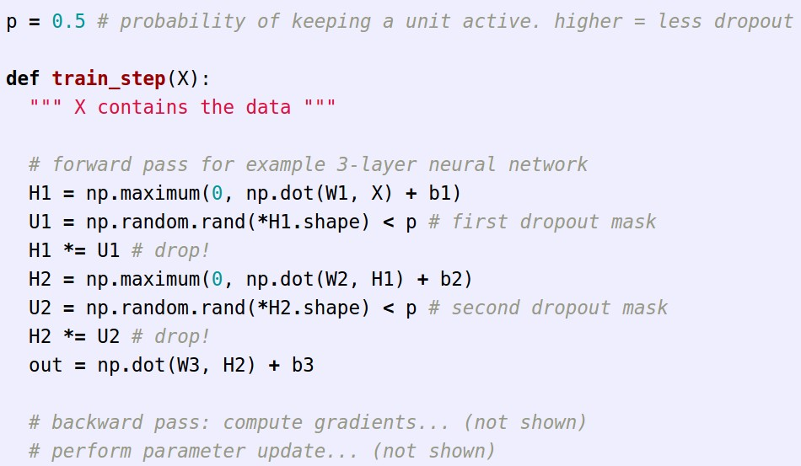
Example forward pass with a 3-layer network using dropout

Slide 53
TLDR: In practice, you should
Use Kaiming Initialization if you ever need to manually assign starting weights.
Try out L2 Norm and Dropout regularization to improve network stability and performance.

Slide 54
Things that could go wrong…
Stopping at a local minimum
  Solution: Choosing a good optimizer and learning rate
Weight explosion
  Solution: Proper initialization and regularization
Overfitting
  Solution: Data augmentation and validation sets
We’ll talk about this one next time

Slide 55
Let’s Try These in PyTorch!

